Slide 1
Interactive Choropleth Maps
Karena Yu, Merck Intern
Notes:
Choropleth map = a map that uses differences in shading, coloring, or the placing of symbols within predefined areas to indicate the average values of a property or quantity in those areas (google dictionary)
R Shiny = Shiny is an R package that makes it easy to build interactive web apps straight from R. (r shiny webpage)

Slide 2
Karena, R Beginner
Notes:
- Intern at Merck IT Hub
- Why I’m here
Merck project = want to view global distribution of some data
WHO data

Slide 3
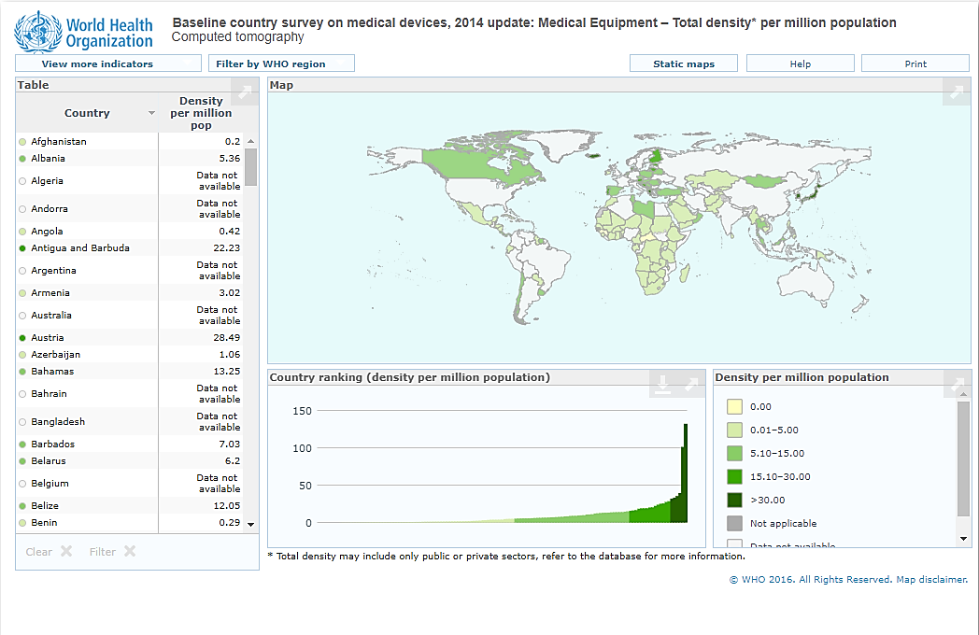
Sneak Peek
Notes:
- Image of data from actual WHO website

Slide 4
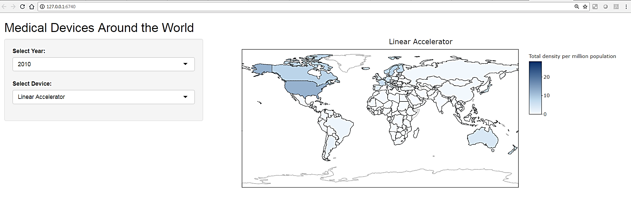
Real Sneak Peek

Slide 5
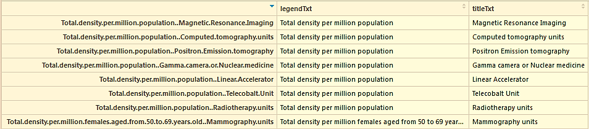
WHO Data
Medical Devices/Equipment by Country (Link to Data)
devices_df
titles
Notes:
World Health Org data: year, devices

Slide 6
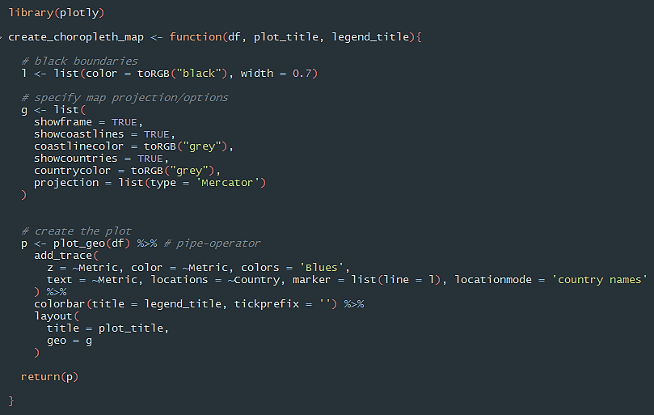
Choropleth map function
Notes:
Assume we have final dataframe (Country, Metric)
other locationmode options include: "ISO-3", "USA-states“
ISO = international organization for standardization
Code from plotly website: https://plot.ly/r/choropleth-maps/

Slide 7
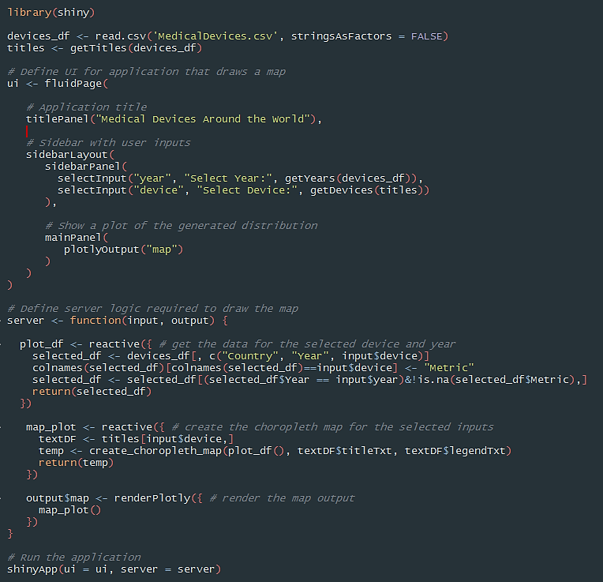

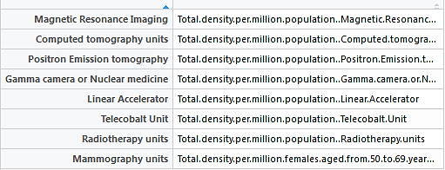
Combine with R Shiny - UI

Slide 8
Combine with R Shiny - Server
Notes:
- by declaring a rendering expression you tell Shiny that it should only be executed when its dependencies change

Slide 9
Questions?
Notes:
- Give live demo, then questions

